Slide 1
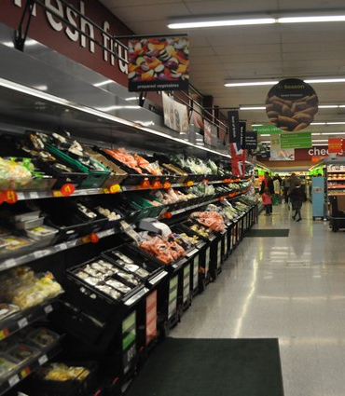
Super Store Sales Dashboard and Forecast Description:
Developed a Power BI Dashboard to analyze sales data, leveraging Time series analysis, for accurate sales forecasting. Utilized data Visualization techniques to provide actionable insights and strategic recommendations for business growth.
Objectives:
Aimed to enhance business success through data analysis and sales forecasting. Achieved this by creating interactive dashboard, Conducted in-depth analysis, forecasting sales trends, and delivered actionable insights.

Slide 2


Slide 3
Superstore Sales Dashboard and Forecast

Slide 4


Recommendations:
Phones, Tables, and Storage are top-performing subcategories. Increasing inventory and promotional campaigns for these items can maximize sales.
Since Standard Class contributes the highest sales volume, improving its efficiency could enhance customer satisfaction and reduce delays.
The South region dominates sales, suggesting opportunities for regional marketing strategies or expansion in other regions to balance growth.
Encourage customers to shift from COD to Online or Card payments to improve cash flow and reduce risks associated with cash transactions.
Sales spikes are evident during certain months; aligning marketing campaigns and inventory management with these trends can capitalize on peak sales periods.
With an average delivery time of 3.85 days, optimizing logistics may improve customer retention and satisfaction.

